Slide 1
bb
7 Insider Tips to
Late-Stage College Planning
Chris Wills
CollegeInsideTrack.com
651 269-2602

Slide 2
Helps over 500,000 students per year with the transition to life after HS
Saves families an average of $18,872 per year off college sticker price

Slide 3
>
529
Late-stage college planning is a significant opportunity to provide value to your clients

Slide 4
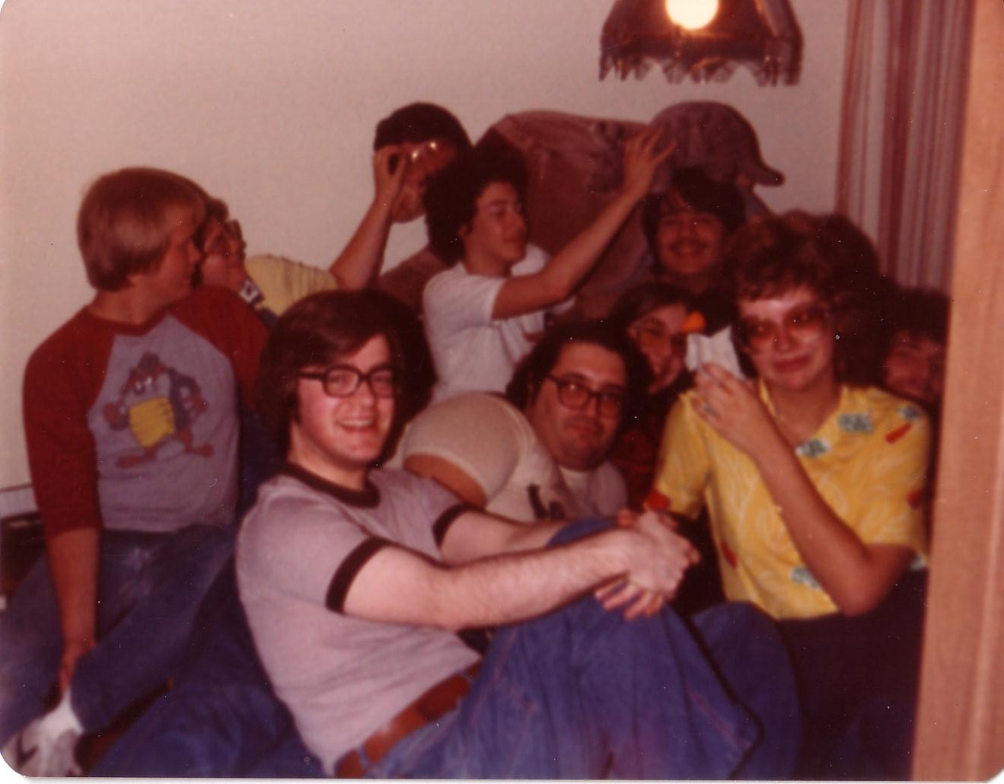
College is different than when we went to school

Slide 5
Quiz
Since 1987, how much has tuition increased at the University of Minnesota?
28%
77%
215%
513%
The numbers on my calculator don’t go that high

Slide 6
U of M Tuition Increase since ‘87
513%
Private College Tuition Increase
401%

Slide 7
Sarah Lawrence U: $68,058
Drexel University: $67,648
NYU: $67,542
Carleton: $62,102
Macalester: $62,100
St. Ben’s (MN): $51,359
St. Thomas: $50,600
University of MN: $25,800

Slide 9
There is no purchase
as significant as college that people know so little about

Slide 10
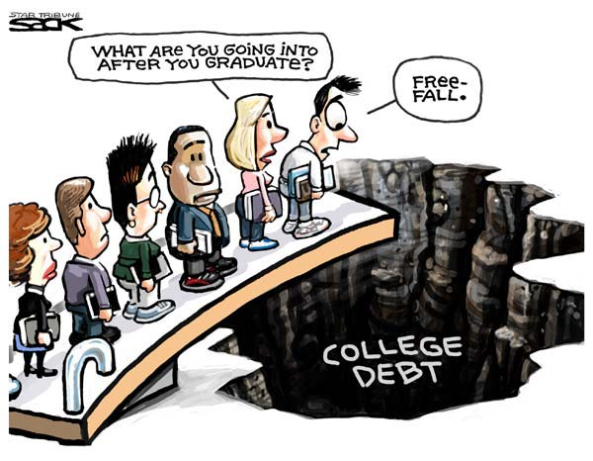

Slide 11
Average Family college debt:
$47,000+ in loans
Includes student & family

Slide 12
What Will College Cost?
1986 annual cost: $ 5,000 to $13,000
2015 annual cost: $19,000 to $69,000
2023 annual cost: $36,000 to $96,500

Slide 14
2 Types of Aid
1. Need-based aid
2. Merit aid

Slide 15
2 Need-based aid forms
FAFSA vs. CSS/Profile
Expected Family Contribution (EFC)

Slide 16
Biggest Influencers of Financial Aid
Income from tax return
Parent non-retirement assets
Number of children in college
Children’s assets and income (UGMA/UTMA, Grandparent donations)

Slide 17
Tip #1
If need-based aid is an option, move assets out of child’s name
Child assessed @ 20%
Parent rate is 5.64%
529 plans are assessed at parent’s rate, UGMA/UTMA at child’s rate

Slide 18
Tip #2
Review financial aid forms for accuracy
42% contain errors that cost a family money
FAFSA-Your primary residence and your retirement are not counted as assets (CSS/Profile is different)

Slide 19
Merit Aid
AP, PSEO, standardized test scores, GPA, sports, etc.

Slide 20
Tip #3
To get the most merit aid, spend the majority of your time finding the right college
(not private scholarships)

Slide 21
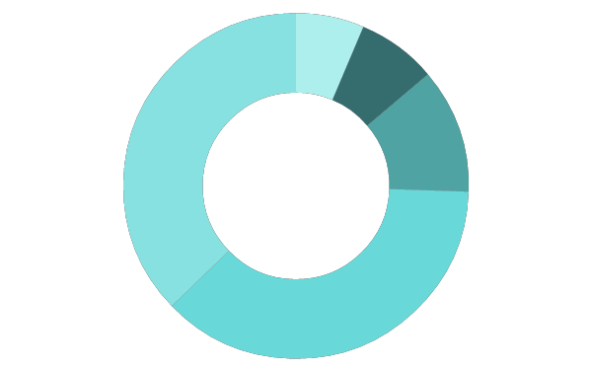
Scholarship/Grant Sources
Federal government
40%
6%
Employers
7%
Private scholarships
Colleges
35%
11%
State governments

Slide 22
#1 mistake families make with merit aid?
Not all colleges offer merit aid!

Slide 23
Look for schools …
Offer merit aid
Where student would bring something special
Grades and test scores in the top 25-33%
Extra-curricular talents
Gender or ethnicity
Geographic diversity

Slide 24
Tip #4
Consider colleges in other states
50% of students attend college within 100 mi of home
MN colleges have all the Minnesotans they want- 72% stay in MN
Students have geographic “hook” by looking at colleges outside geographic area
Location can cost families $15,000 a year

Slide 25
Tip #5
1 or 2 more points on the ACT or SAT can be worth $1,000’s
Goal is to be in top 25% of college’s scores
Investment in test prep may be worth it
Test optional - If student does poorly on standardized tests consider 800+ colleges that do not require them (www.fairtest.org)

Slide 26
Anatomy of 1 College’s Merit Aid
Demonstrated Interest- $3,000 (Don’t be “stealth” candidate)
Lives out of state-$2,000-$15,000
“A” in class-$62 for every “A” on transcript
Rigorous class-$400 for every AP, IB, etc.
Excellent letter of recommendation-$1,800
Increase ACT score-$425 for every point above avg.
FAFSA-$1,800 for completing
CSS/Profile-$2,500 for completing
Essay-$1,100-8,500 for excellent essay
Major- deduct $1.89 for every student admitted w/ same major (good news for philosophy majors!)

Slide 27
Tip #6
Negotiate the financial aid award
Called an “appeal,” dirty little secret colleges don’t want you to know about
Need a reason like a better offer from another college, family circumstance change, etc.
Last year our appeals saved our clients an average of $8,200 per year ($32,800 over the 4 years)

Slide 28
Tip #7
Start the spring of 10th grade
FAFSA change – will use financial data from 2 years prior starting with class of 2017
Research and then target schools based on predicted aid
Give yourself enough time to retake ACT if needed

Slide 29
For presentation slides, text your email to 651-269-2602 or email chris@collegeinsidetrack.com.
We do free customer appreciation or new client education events for financial advisors
Referrals are appreciated and we will provide 1 hour of free college consulting
Contact me anytime with questions!

Slide 30
Questions?
Chris Wills
CollegeInsideTrack.com
651-269-2602 (cell)
chris@collegeinsidetrack.com

