Slide 1
bb
7 Insider Tips to
Navigate the College Process
Chris Wills
CollegeInsideTrack.com
651 269-2602

Slide 2
Saves families an average of $75,488 off college sticker price
*Source: 2015 College Inside Track graduating senior analysis

Slide 3
College is different than when we went to school

Slide 4
Quiz
Since 1987, how much has tuition increased at the University of Minnesota?
28%
77%
215%
557%
The numbers on my calculator don’t go that high
*Sources: Minnesota System-Level Undergraduate Tuition & Fee Trends and University of Minnesota Costs accessed of 8-17-17

Slide 5
U of M Tuition Increase since ‘87
557%
Private College Tuition Increase
413%
*Source: College Board Tuition and Fees and Room and Board over Time accessed 8-17-17

Slide 6
NYU: $71,754
Drexel University: $69,489
Sarah Lawrence U: $67,130
Carleton: $64,420
Macalester: $61,853
St. Thomas: $54,100
St. Ben’s (MN): $53,477
University of MN: $26,304
*Source: Collegedata.com, accessed 8-17-17

Slide 8
There is no purchase
as significant as college that people know so little about

Slide 9
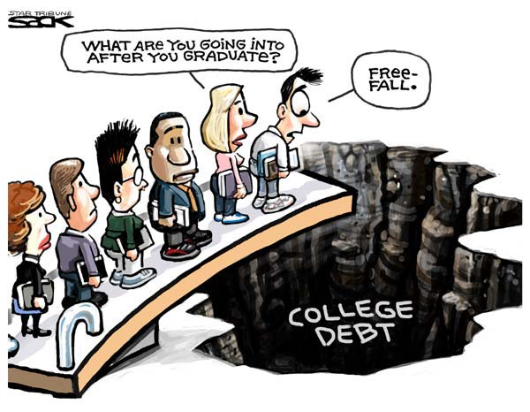

Slide 10
Average family college debt:
$57,800 in loans
Includes student & family
*Sources: Nerdwallet.com Got Parent PLUS Loans? Save Money With These Alternative Payment Plans and The Institute for College Access and Success accessed 8-18-17

Slide 11
Treat this decision like the major
financial investment that it is.

Slide 13
2 Types of Aid
1. Need-based aid
2. Merit aid

Slide 14
2 Need-based aid forms
FAFSA vs. CSS/Profile
Expected Family Contribution (EFC)

Slide 15
Biggest Influencers of Financial Aid
Income from tax return
Parent non-retirement assets
Number of children in college
Children’s assets and income (UGMA/UTMA, Grandparent donations)

Slide 16
Tip #1
If need-based aid is an option, move assets out of child’s name
Child assessed @ 20%
Parent rate is 5.64%
529 plans are assessed at parent’s rate, UGMA/UTMA at child’s rate
*Source: Forbes 2017 Guide to College Financial Aid accessed 8-18-17

Slide 17
Tip #2
Review financial aid forms for accuracy
42% contain errors that cost a family money
FAFSA-Your primary residence and your retirement are not counted as assets (CSS/Profile is different)
*Source: 2015 College Inside Track graduating senior analysis

Slide 18
Merit Aid
AP, PSEO, standardized test scores, GPA, sports, etc.

Slide 19
Tip #3
To get the most merit aid, families should spend the majority of their time finding the right college
(not private scholarships)

Slide 20
Scholarship/Grant Sources
Federal government
40%
6%
Employers
7%
Private scholarships
Colleges
35%
11%
State governments

Slide 21
One huge mistake families make with merit aid?
Not all colleges offer merit aid!

Slide 22
Look for schools …
Offer merit aid
Where student would bring something special
Grades and test scores in the top 25-33%
Extra-curricular talents
Gender or ethnicity

Slide 23
Tip #4
Consider colleges in other states
58% of students attend college within 100 mi of home
Local colleges have all the local students they want - 72% stay in their home state
Students have geographic “hook” by looking at colleges outside geographic area
Families can save thousands per year
*Source: Niche Ink: Going Away to College accessed 8-18-17

Slide 24
Tip #5
1 or 2 more points on the ACT or SAT can be worth $1,000’s
Goal is to be in top 25% of college’s scores
Investment in test prep may be worth it
Test optional - If student does poorly on standardized tests consider 800+ colleges that do not require them (www.fairtest.org)

Slide 25
Anatomy of 1 College’s Merit Aid
Demonstrated Interest- $3,000 (Don’t be “stealth” candidate)
Lives out of state-$2,000-$15,000
“A” in class-$62 for every “A” on transcript
Rigorous class-$400 for every AP, IB, etc.
Excellent letter of recommendation-$1,800
Increase ACT score-$425 for every point above avg.
FAFSA-$1,800 for completing
CSS/Profile-$2,500 for completing
Essay-$1,100-8,500 for excellent essay
Major- deduct $1.89 for every student admitted w/ same major (good news for philosophy majors!)

Slide 26
Tip #6
Negotiate the financial aid award
Called an “appeal,” dirty little secret colleges don’t want you to know about
Need a reason like a better offer from another college, family circumstance change, etc.
Last year our appeals saved our clients an average of $7,883 per year ($31,532 over the 4 years)

Slide 27
Tip #7
Start the spring of 10th grade or ASAP
FAFSA change – will use financial data from 2 years prior starting with class of 2017
Research and then target schools based on predicted aid
Give yourself enough time to retake ACT if needed

Slide 28
What We Do
Just like you hire a realtor for the major purchase of a home, you hire us for the major purchase of college
You can do it on your own, but you will often cost yourself money

Slide 29
We help navigate the complicated process and find the right fit

Slide 30
We help families save lots of money

Slide 31
We are a neutral third-party
that students listen to

Slide 32
Services
Comprehensive package is $4995 that can be paid over time
If student applies to merit aid schools, we'll pay for ourselves by helping you find free money at least equal to our fee, or we'll refund the difference.

Slide 33
Please complete feedback form to request copy of PowerPoint or sign up for our e-newsletter (we are a spam-free zone!)
We offer private event “Pizza Nights” for friends, sports teams, churches, etc.
For any attendees, we will provide 1 free hour of college consulting

Slide 34
Questions?
Cozy Wittman
CollegeInsideTrack.com
612-850-5729 (cell)
cwittman@collegeinsidetrack.com
Like us on Facebook
@collegeinsidetrack

