Slide 1
Interpreting Award Letters
Creating Transparency for Families!
Cozy Wittman
cwittman@collegeinsidetrack.com
612-850-5729

Slide 2
Acceptance is just the beginning… now what?
Financial Strategies Overview
Acceptance letters
Financial Award Letters
Appeals
Your Turn!

Slide 3
Assure there is a strategy to pay for college
4 year plan & a budget
Discuss early in the search process
Define expectations for both parents & kids
Notes:
DO FINANCES POLL!

Slide 4
Scholarships: Need vs. Merit
Need
Merit
Determined by FAFSA outcome and potentially the CSS profile
Based on aspects of the student the college deems most beneficial to them
Grant or scholarship from the college
Grant or scholarship from the college
Re-evaluated every year
Typically last for the entire 4 years, ask if unclear
Nearly all schools address some level of need but the vast majority leave much of it uncovered
NOT ALL COLLEGES GIVE MERIT AID and it varies greatly school to school
Notes:
Read Slide

Slide 5
Acceptance Letters
Determine the acceptance to a school
May include important info on the student portal that will hold their full financial package
May include a letter for early merit based scholarship money
Typically does NOT contain complete financial aid info

Slide 6
Financial Award Letters
Sent by the Office of Financial Aid and should include: tuition, room & board, books, fees, work study, grants & scholarships, and loans
Confusing Jargon and Terminology: Shortened words or alt words for loans
Omission of the Complete Cost: 1/3+ did not share cost info – just the award
Failure to Differentiate Types of Aid: 70%, grouped all aid together.*
Inconsistent Bottom Line Calculations: 40 percent calculated what students would pay, 23 different ways to calculate “net price”
* Decoding the Cost of College The Case for Transparent Financial Aid Award Letters
- New American, June 2018

Slide 7
Financial Award Letters
No Clear Next Steps: Only 50% provided information about what to do next
Vague Definitions and Poor Placement of Work-Study: 70 percent provided no explanation of work-study and how it differs from other types of aid.*
Misleading Packaging of Parent PLUS Loans: Nearly 15 percent of letters included a PLUS loan as an “award,” making the financial aid package appear far more generous than it really was.*
* Decoding the Cost of College The Case for Transparent Financial Aid Award Letters
- New American, June 2018

Slide 8
How to Interpret a Financial Aid Award Letter
The true cost of college is net price. Net price is the difference between total college costs and just the gift aid (grants and scholarships). The net price is a discounted sticker price. It is the amount of money the family must pay from savings & income to cover college costs.
Sticker Price
-
Gift Aid
=
Net Price

Slide 9
Net Cost vs Net Price
Net Cost/Sticker Price
Yearly cost of a college before aid is applied:
Tuition
Room & Board
Books
Fees like a lab, health care, IT or parking
Net Price
What the student will actually pay:
Subtracts Grants & Scholarships
Unique to each student
Number before consideration of loans

Slide 10
Bad Financial Award Letter

Slide 11
What is Missing?
Omits indirect & understates actual total cost of attending.
Limits award names to 15 characters, leaving a parent to interpret “L”
Mixes loans and grants in a seemingly random order & separates the Federal Loan like it’s two different loans
Does not include information about Interest rates and loan payments
Inclusion of the Federal Parent PLUS loan reduces the net cost to a level that seems reasonable to families
Presents a net cost vs net price figure. Focused on cost payable to school vs cost to the family.

Slide 12
Good Award Letter

Slide 13
Key Questions to Ask Their Colleges!
Is full demonstrated financial need met?
How will outside scholarships impact the college’s financial package?
Are the grants freshman only or are they guaranteed for all 4 years?
Are the scholarships guaranteed for all 4 years and what are the requirements to keep them?
How much have college’s costs increased in the last three years?
What are the residency requirements for in-state public college tuition?
How does work study run at this college?
How many years are students required to live on campus?

Slide 14
Reasons to Appeal
Changed financial circumstances
Detailed as possible- salary changes, lay offs, medical bills, etc.
Will likely require proof
Better offer from competing school.
Know your EFC
Can’t possibly determine if an award is a good one unless you know your EFC, which represents what family is expected to pay at a minimum for one year of college.
Example: Financial need, after subtracting EFC, is $30,000 and the school is only offering $10,000 in financial aid. That’s a poor award.

Slide 15
Reasons NOT to appeal
School does NOT provide merit aid
Student has no interest in attending
Public Institutions DO NOT appeal
COVID providing some opportunity

Slide 16
Don’t Commit too Early
Don’t send in the deposit
Sending the deposit surrenders any leverage you have to appeal
Students shout NOT commit until all awards are in
Offers made remain on the table until the May 1 deadline
Don't call it a negotiation
Colleges “appeal” based on circumstances not because you feel the price is too high

Slide 17
Your Turn!
What’s missing and is it a good award letter or a misleading award letter

Slide 18
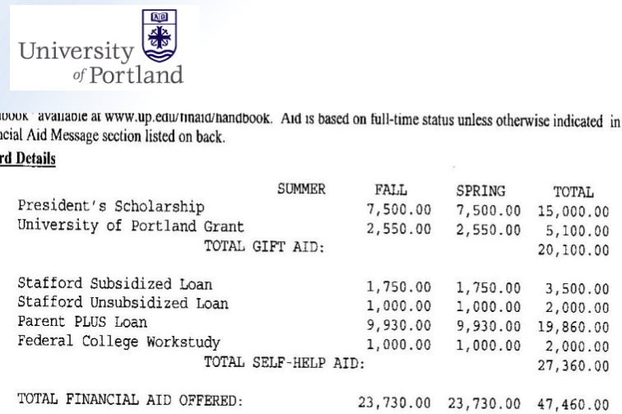

Slide 20
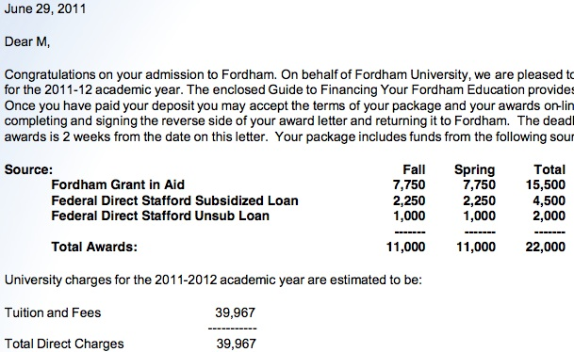

Slide 22
What we do!
Just like realtors understand the housing industry, College Inside Track helps families navigate the college search landscape and understand the “behind the scenes” things.
You can do it on your own, but you will often cost yourself money.

Slide 23
We help navigate the complicated process and find the right fit

Slide 24
We ensure you get best pricing for your list schools

Slide 25
We are a neutral third-party that students listen to
Notes:
The resolution on this photo is poor. If you want to use the image, I recommend purchasing the full-res image from Getty:
https://www.istockphoto.com/photo/woman-yelling-through-a-bullhorn-at-an-unfazed-teenage-girl-gm172808685-5586427

Slide 26
Free Family Consultation
Answer your questions
Discuss your goals and suggest strategies
Rough EFC – FAFSA outcome
Suggest the right path – need vs merit or both

Slide 27
Housekeeping!
Sophomore/Junior families - Take advantage of the hour consultation – fill out your google form!
Student too young – fill it out – we’ll reach out when ready!
Follow us on Facebook/Family Newsletter
Share us with people you know!

Slide 28
Questions?
Cozy Wittman
cwittman@collegeinsidetrack.com
612-850-5729

