Slide 1



bb
College Financial Aid Strategies You Don’t Know About But Should
Cozy Wittman
CollegeInsideTrack.com
612-850-5729

Slide 2
Saves families an average of $75,488 off college sticker price
*Source: 2015 College Inside Track graduating senior analysis

Slide 3

College is different than when we went to school

Slide 4
Quiz
Since 1987, how much has tuition increased at the University of Minnesota?
28%
77%
215%
557%
The numbers on my calculator don’t go that high
*Sources: Minnesota System-Level Undergraduate Tuition & Fee Trends and University of Minnesota Costs accessed of 8-17-17

Slide 5
U of M Tuition Increase since ‘87
557%
Private College Tuition Increase
413%
*Source: College Board Tuition and Fees and Room and Board over Time accessed 8-17-17

Slide 6


Slide 7

There is no purchase
as significant as college that people know so little about

Slide 8


Slide 9

Any discussion of
“college fit” today must include academic, social AND financial fit

Slide 10


Slide 11


Understand how to evaluate a financial aid offer
Tip #1

Slide 12
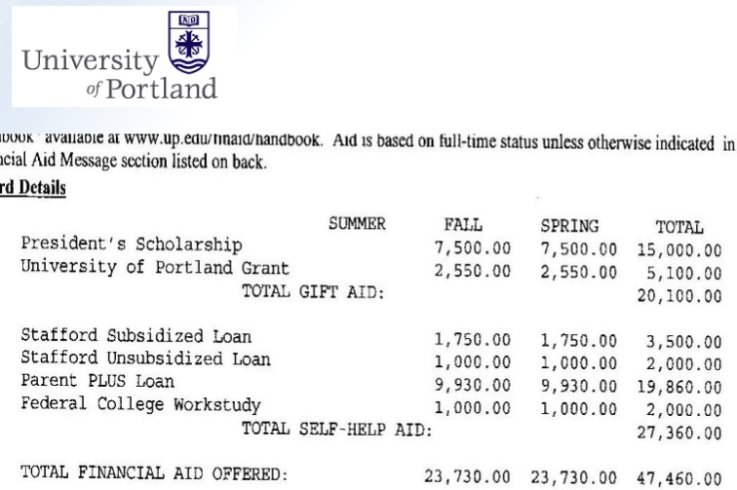

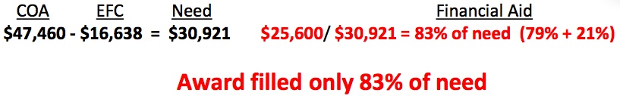

Slide 13

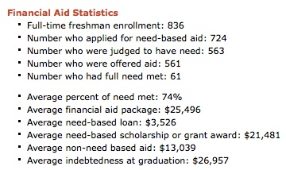

Slide 14
Tip #2
529 Plans
Tax-free college savings vehicle if used for qualified higher ed expenses
New tax benefits for MN residents
  Tax deduction up to $3,000 per year or tax credit up to $500 per year
Withdrawals up to amount of scholarships can be taken penalty free (still pay taxes on any earnings)

Slide 15


Biggest Influencers of
Need-Based Financial Aid
Income from tax return
Parent non-retirement assets
Number of children in college
Children’s assets and income (UGMA/UTMA, Grandparent donations)

Slide 16
Tip #3
If need-based aid is an option, minimize assets in child’s name
Child assessed @ 20%
Parent rate is 5.64%
529 plans are assessed at parent’s rate

Slide 17

Tip #4
Avoid FAFSA mistakes
Value of primary residence
Retirement assets
Divorced families
Value of small business

Slide 18

Merit Aid
AP, PSEO, standardized test scores, GPA, sports, etc.

Slide 19
Look for schools …
Who offer merit aid
Where student would bring something special
  Grades and test scores in the top 25%
  Extra-curricular talents
  Gender or ethnicity

Slide 20
Tip #5
Consider colleges in other states
50% of students attend college within 100 mi of home
MN colleges have all the Minnesotans they want- 72% stay in MN
Students have geographic “hook” by looking at colleges outside geographic area
Location can gain families $15,000 a year

Slide 21
Tip #6
1 or 2 more points on the ACT or SAT can be worth $1,000’s
Goal is to be in top 25% of college’s scores
Investment in test prep may be worth it
Test optional - If student does poorly on standardized tests consider 800+ colleges that do not require them (www.fairtest.org)

Slide 22

Tip #7
Negotiate the financial aid award
Called an “appeal,” dirty little secret colleges don’t want you to know about
Need a reason
Last year our appeals saved our clients an average of $7,883 per year ($31,532 over the 4 years)

Slide 23

For presentation slides, text your email to 612-850-5729 or email cwittman@collegeinsidetrack.com.
We offer free parent nights for high schools
Contact me anytime with questions!

