Slide 1
bb
8 Insider Tips to
Late-Stage College Planning
Cozy Wittman
CollegeInsideTrack.com
612-850-5729
FPA of Iowa

Slide 2
College Inside Track saves families an average of $75,488 off the four year college sticker price!

Slide 3
More than 529’s!
Late-stage college planning is a significant opportunity to provide value to your clients

Slide 4
College is different than when we went to school

Slide 5
3 Key Factors For Success
Academic
Social
Financial

Slide 6
Quiz
Since 1986, how much has tuition increased at the University of Iowa?
28%
77%
215%
561%
I will need use of my T1 calculator!

Slide 7
U of Iowa Tuition Increase Since ‘86
561%
Private College Tuition Increase
401%

Slide 8
NYU: $70,444
Drexel University: $69,489
Sarah Lawrence U: $67,130
Grinnell: $63,114
Drake: $54,020
Loras: $43,885
University of Iowa: $22,606
Iowa State University: $20,606

Slide 10
There is no purchase
as significant as college that people know so little about

Slide 11
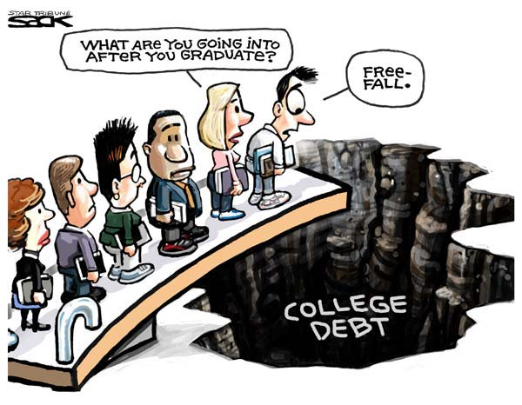

Slide 12
Average family college debt:
$57,800 in loans
Includes student & family
*Sources: Nerdwallet.com Got Parent PLUS Loans? Save Money With These Alternative Payment Plans and The Institute for College Access and Success accessed 8-18-17

Slide 13
What Will College Cost?
1986 annual cost: $5,000 to $13,000
2016 annual cost: $20,000 to $70,000
2025 annual cost: $53,000 to $102,000

Slide 14
2 Types of Aid
1. Need-based aid
2. Merit aid

Slide 15
2 Need-based aid forms
FAFSA vs. CSS/Profile
Expected Family Contribution (EFC)

Slide 16
Biggest Influencers of Financial Aid
Income from tax return
Parent non-retirement assets
Number of children in college
Children’s assets and income (UGMA/UTMA, Grandparent donations)

Slide 17
Tip #1
If need-based aid is an option, move assets out of child’s name
Child assessed @ 20%
Parent rate is 5.64%
529 plans are assessed at parent’s rate, UGMA/UTMA at child’s rate

Slide 18
Tip #2
Grandparent 529 plans
Aren’t disclosed on FAFSA
Delay distribution

Slide 19
Tip #3
Review financial aid forms for accuracy
42% contain errors that cost a family money
FAFSA -Your primary residence and your retirement are not counted as assets (CSS/Profile is different)

Slide 20
Merit Aid
AP, PSEO, standardized test scores, GPA, sports, etc.

Slide 21
Tip #4
To get the most merit aid, spend the majority of your time finding the right college (not private scholarships)

Slide 22
Scholarship/Grant Sources
Federal government
40%
6%
Employers
7%
Private scholarships
Colleges
35%
11%
State governments

Slide 23
#1 mistake families make with merit aid?
Not all colleges offer merit aid!

Slide 24
Look for schools …
Offer merit aid
Where student would bring something special
Grades and test scores in the top 25-33%
Extra-curricular talents
Gender or ethnicity
Geographic diversity

Slide 25
Tip #5
Consider colleges in other states
50% of students attend college within 100 mi of home
Iowa colleges have all the Iowans they want
Students have geographic “hook” by looking at colleges outside geographic area
Location can cost families $15,000 a year

Slide 26
Tip #6
1 or 2 more points on the ACT or SAT can be worth $1,000’s
Goal is to be in top 25% of college’s scores
Investment in test prep may be worth it
Test optional - If student does poorly on standardized tests consider 1000+ colleges that do not require them (www.fairtest.org)

Slide 27
Anatomy of 1 College’s Merit Aid
Demonstrated Interest- $3,000 (Don’t be “stealth” candidate)
Lives out of state-$2,000-$15,000
“A” in class-$62 for every “A” on transcript
Rigorous class-$400 for every AP, IB, etc.
Excellent letter of recommendation-$1,800
Increase ACT score-$425 for every point above avg.
FAFSA-$1,800 for completing
CSS/Profile-$2,500 for completing
Essay-$1,100-8,500 for excellent essay
Major- deduct $1.89 for every student admitted w/ same major (good news for philosophy majors!)

Slide 28
Tip #7
Negotiate the financial aid award
Called an “appeal,” secret colleges don’t want you to know about
Need a reason
Last year our appeals saved our clients an average of $7,883 per year ($31,532 over the 4 years)

Slide 29
Tip #8
Start the spring of 10th grade
FAFSA change – now uses financial data from 2 years prior starting with class of 2017
Research and then target schools based on predicted aid
Give yourself enough time to retake ACT if needed

Slide 30
Free Family Consultation
Answer your questions about the college process
Calculate the estimated amount (EFC) the gov’t expects you to contribute toward college
Advise you on your eligibility for need-based and merit aid

Slide 31
4 ways we can provide tremendous value to you
Build us into your annual client review process and we will provide 1 hour of free college consulting
Partnered, free private events for high schools, sports teams, churches, etc. to generate prospects
Client events to add value to the relationship
Monthly content to use on your social media, newsletters, etc.

Slide 32
Questions?
Cozy Wittman
Education /Partnerships
612-850-5729 (cell)
cwittman@collegeinsidetrack.com

