Slide 1
bb
Late-Stage College Planning Strategies You Don’t Know About But Should
Chris Wills
CollegeInsideTrack.com
651-269-2602

Slide 2
Saves families an average of $75,488 off college sticker price

Slide 3
Late-stage college planning
A significant opportunity to provide value to your clients

Slide 4
Quiz
On average, how many minutes of personalized college counseling do US public HS students receive in their 4 years of HS?
38 minutes
2 hours
10 hours
25 hours
As much as they want

Slide 5
Quiz
On average, how many minutes of personalized college counseling do US public HS students receive in their 4 years of HS?
38 minutes

Slide 6
NYU: $71,754
Southern Cal: $69,711
Notre Dame: $67,043
Rice: $60,518
St. Thomas (MN): $54,100
Ohio State: $25,539
Univ of North Carolina: $24,630
*Source: Collegedata.com, accessed 8-17-17

Slide 8
There is no purchase
as significant as college that people know so little about

Slide 9
Understand that colleges have different financial aid policies
Strategy #1

Slide 10
Tuition/fees $38,000
Room and board $ 8,500
Books, supplies $ 1,500
Misc. $ 2,500
Total annual cost $50,500
- EFC (FAFSA) - $20,000
= Remaining Student Need $30,500
YOUR FINANCIAL PACKAGE:
NOT met by the school (25%) $ 7,625
Total need school will meet (75%) $ 22,875
Student loan $ 5,500
Work Study $ 2,000
Parent Loan (PLUS) $ 5,500
Grants and scholarships $ 9,875
= Out-of-pocket costs $38,625

Slide 11
Your turn to be a financial aid counselor!

Slide 12
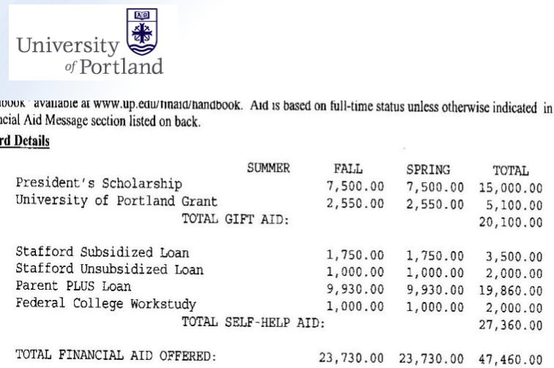

Slide 15
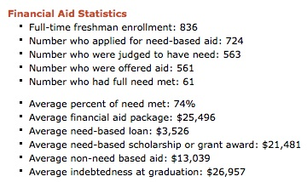

Slide 16
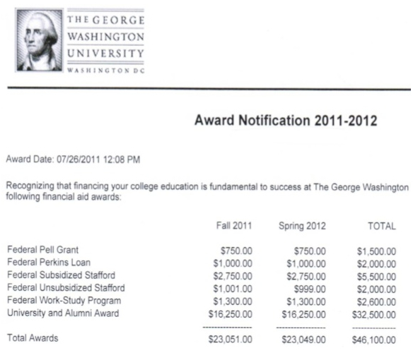

Slide 18
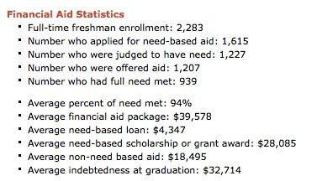

Slide 19
What should be in every financial aid award letter
Full cost of attendance broken down into expenses such as tuition, room and board, etc.
Grants and scholarships
Types and amounts of loans, including interest rates
Net amount owed after financial aid is deducted
Family’s expected family contribution

Slide 20
Strategy #2
Avoid losing aid
Don’t maintain academic requirements
Don’t fill out financial aid forms on time for subsequent years
Transfer

Slide 21
Scholarship Award Displacement
Strategy #3
The dirty little secret of financial aid
Ask for loans to be removed first

Slide 22
Strategy #4
Grandparent 529 plans
Aren’t disclosed on FAFSA
Delay distribution

Slide 23
What We Do
Just like you hire a realtor for the major purchase of a home, you hire us for the major purchase of college
You can do it on your own, but you will often cost yourself money

Slide 24
We help navigate the complicated process and find the right fit

Slide 25
We help families save lots of money

Slide 26
We are a neutral third-party
that students listen to

Slide 27
Services
Comprehensive package is $4995 that families can pay over time
We'll pay for ourselves by finding free money at least equal to our fee, or we'll refund the difference
Ideal client is parent or grandparent with sophomore or junior in HS

Slide 28
Chris Wills
Call or Text: 651-269-2602
chris@collegeinsidetrack.com
4 ways we can provide tremendous value to you
Build us into your client review process and we will provide 1 hour of free college consulting to make you look good
Multi-generational bridge to children of older clients
Client events
Free private events for high schools, sports teams, churches, etc.

Slide 29
Chris Wills
CollegeInsideTrack.com
Call or Text: 651-269-2602
chris@collegeinsidetrack.com
For presentation slides, text or email me
Contact me anytime with questions!

