Slide 1
bb
8 Insider Tips to
Late-Stage College Planning
Cozy Wittman
CollegeInsideTrack.com
612-850-5729

Slide 2
College Inside Track saves families an average of $75,488 off the four year college sticker price!

Slide 3
More than 529’s!
Late-stage college planning is a significant opportunity to provide value to your clients

Slide 4
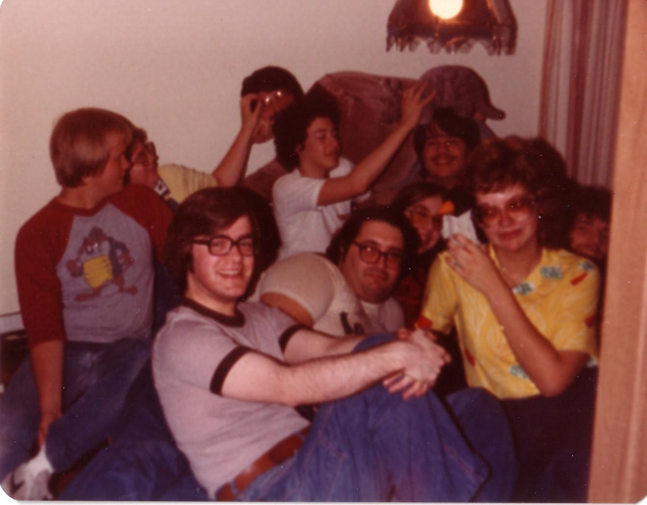
College is different than when we went to school

Slide 5
3 Key Factors For A Successful Search!
Academic
Social
Financial

Slide 6
Quiz
Since 1987, how much has tuition increased at the University of Kansas?
77%
145%
325%
641%
Wish I had my T1 about now

Slide 7
U of KS Tuition Increase since ‘87
641%
Private College Tuition Increase
415%

Slide 8
Northwestern University: $75,753
NYU: $74,676
Stanford University: $74,570
Washington University: $74,361
St Louis University: $57,214
Rockhurst: $49,900
William Jewell: $34,421
University of KS: $25,212

Slide 10
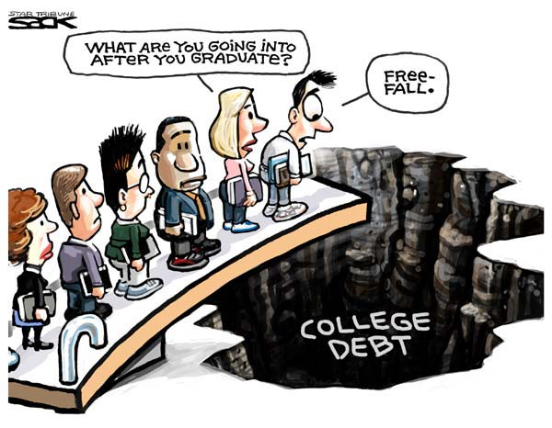

Slide 11
Average family college debt:
$57,800 in loans
Includes student & family
*Sources: Nerdwallet.com Got Parent PLUS Loans? Save Money With These Alternative Payment Plans and The Institute for College Access and Success accessed 8-18-17

Slide 12
2 Types of Aid
1. Need-based aid
2. Merit aid

Slide 13
2 Need-based aid forms
FAFSA vs. CSS/Profile
Expected Family Contribution (EFC)

Slide 14
Biggest Influencers of Financial Aid
Income from tax return
Parent non-retirement assets
Number of children in college
Children’s assets and income (UGMA/UTMA, Grandparent donations)

Slide 15
Tip #1
If need-based aid is an option, move assets out of child’s name
Child assessed @ 20%
Parent rate is 5.64%
529 plans are assessed at parent’s rate, UGMA/UTMA at child’s rate

Slide 16
Tip #2
Review financial aid forms for accuracy
42% contain errors that cost a family money
FAFSA-Your primary residence and your retirement are not counted as assets (CSS/Profile is different)

Slide 17
Tip #3
Grandparent 529 plans
Aren’t disclosed on FAFSA
Delay distribution

Slide 18
Merit Aid
AP, PSEO, standardized test scores, GPA, activities, sports, etc.

Slide 19
Tip #4
To get the most merit aid, spend the majority of your time finding the right college
(not private scholarships)

Slide 20
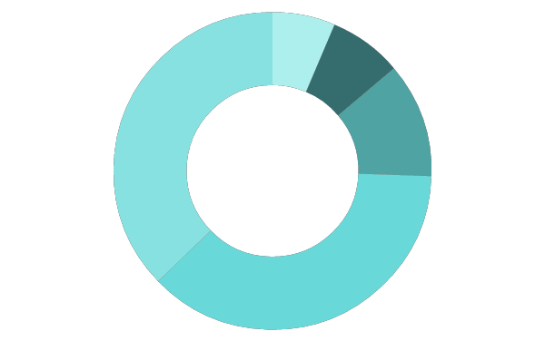
Scholarship/Grant Sources
Federal government
40%
6%
Employers
7%
Private scholarships
Colleges
35%
11%
State governments

Slide 21
Top 2 mistakes families make with merit aid?
Not all colleges offer merit aid!
Narrow the field of colleges too soon!

Slide 22
Look for schools …
Offer merit aid
Where student would bring something special
Grades and test scores in the top 25-33%
Extra-curricular talents
Gender or ethnicity

Slide 23
Tip #5
Consider colleges in other states
50% of students attend college within 100 mi of home
KS colleges have all the Kansans they want- 72% stay in KS
Students have geographic “hook” by looking at colleges outside geographic area
Location can cost families $15,000 a year

Slide 24
Anatomy of 1 College’s Merit Aid
Demonstrated Interest- $3,000 (Don’t be “stealth” candidate)
Lives out of state-$2,000-$15,000
“A” in class-$62 for every “A” on transcript
Rigorous class-$400 for every AP, IB, etc.
Excellent letter of recommendation-$1,800
Increase ACT score-$425 for every point above avg.
FAFSA-$1,800 for completing
CSS/Profile-$2,500 for completing
Essay-$1,100-8,500 for excellent essay
Major- deduct $1.89 for every student admitted w/ same major (good news for philosophy majors!)

Slide 25
Tip #7
Negotiate the financial aid award
Called an “appeal,” a little secret colleges don’t want you to know about
Need a reason like a better offer from another college, family circumstance change, etc.
Last year our appeals saved our clients an average of $7,883 per year ($31,532 over the 4 years)

Slide 26
Tip #7
Start the spring of 10th grade
Time is the enemy of a great college search!
Research and then target schools based on predicted aid
Give yourself enough time to retake ACT if needed

Slide 27
What We Do
Just like you hire a realtor for the major purchase of a home, you hire us for the major purchase of college
You can do it on your own, but you will often cost yourself money

Slide 28
We help navigate the complicated process and find the right fit

Slide 29
We help families save lots of money

Slide 30
We are a neutral third-party
that students listen to

Slide 31
Services
Comprehensive package is $4995 that can be paid over time
We'll pay for ourselves by helping your clients find free money at least equal to our fee, or we'll refund the difference.

Slide 32
4 ways we can provide tremendous value to you
Build us into your annual client review process and we will provide 1 hour of free college consulting for all referrals
Client events
Monthly content to use on your social media, newsletters, etc.

Slide 33
Questions?
Cozy Wittman
CollegeInsideTrack.com
612-850-5729 (cell)
cwittman@collegeinsidetrack.com

