Slide 1
bb
5 Insider Tips to
Late-Stage College Planning
Chris Wills
CollegeInsideTrack.com
651-269-2602

Slide 2
Saves families an average of $75,488 off college sticker price
*Source: 2015 College Inside Track graduating senior analysis

Slide 3
>
529
Late-stage college planning is a significant opportunity to provide value to your clients
Notes:
Most advisors’ exposure to college planning starts and ends with 529 plans. But late-stage college planning offers another huge untapped opportunity to add value and potentially gain business

Slide 4
College is different than when we went to school

Slide 5
Quiz
Since 1987, how much has tuition increased at the University of Minnesota?
28%
77%
215%
557%
The numbers on my calculator don’t go that high
*Sources: Minnesota System-Level Undergraduate Tuition & Fee Trends and University of Minnesota Costs accessed of 8-17-17

Slide 6
U of M Tuition Increase since ‘87
557%
Private College Tuition Increase
413%
*Source: College Board Tuition and Fees and Room and Board over Time accessed 8-17-17

Slide 7
NYU: $73,208
USC: $72,277
Boston College: $70,588
Carleton: $68,835
Macalester: $66,280
St. Ben’s (MN): $56,880
St. Thomas: $55,933
University of MN: $28,304
Notes:
UNC this year: $23,000 – this year.

Slide 9
There is no purchase
as significant as college that people know so little about

Slide 10
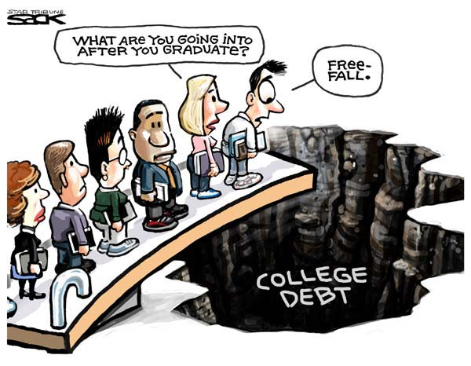

Slide 11
Notes:
Just like many people on a flight pay a different price and don’t really understand why, the same goes for students in an incoming freshman class

Slide 12
2 Types of Aid
1. Need-based aid
2. Merit aid

Slide 13
2 Need-based aid forms
FAFSA vs. CSS/Profile
Expected Family Contribution (EFC)

Slide 14
Biggest Influencers of Financial Aid
Income from tax return
Parent non-retirement assets
Number of children in college
Children’s assets and income (UGMA/UTMA, Grandparent donations)

Slide 15
Strategy #1
If need-based aid is an option, move assets out of child’s name
Child assessed @ 20%
Parent rate is 5.64%
529 plans are assessed at parent’s rate, UGMA/UTMA at child’s rate

Slide 16
Strategy #2
Review financial aid forms for accuracy
42% contain errors that cost a family money
FAFSA -Your primary residence and your retirement are not counted as assets (CSS/Profile is different)

Slide 17
Merit Aid

Slide 18
One huge mistake families make with merit aid?
Not all colleges offer merit aid!

Slide 19
Look for schools…
Offer merit aid
Where student would bring something special
Grades and test scores in the top 25-33%
Extra-curricular talents
Gender or ethnicity

Slide 20
Strategy #3
Consider colleges in other states
50% of students attend college within 100 mi of home
Students have geographic “hook” by looking at colleges outside geographic area
Location can cost families $15,000 a year

Slide 21
Strategy #4
1 or 2 more points on the ACT or SAT can be worth $1,000’s
Goal is to be in top 25% of college’s scores
Investment in test prep may be worth it
Test optional - If student does poorly on standardized tests consider 900+ colleges that do not require them (www.fairtest.org)

Slide 22
Anatomy of 1 College’s Merit Aid
Demonstrated Interest- $3,000 (Don’t be “stealth” candidate)
Lives out of state-$2,000-$15,000
“A” in class-$62 for every “A” on transcript
Rigorous class-$400 for every AP, IB, etc.
Excellent letter of recommendation-$1,800
Increase ACT score-$425 for every point above avg.
FAFSA-$1,800 for completing
CSS/Profile-$2,500 for completing
Essay-$1,100-8,500 for excellent essay
Major- deduct $1.89 for every student admitted w/ same major (good news for philosophy majors!)

Slide 23
Strategy #5
Negotiate the financial aid award
Called an “appeal,” dirty little secret colleges don’t want you to know about
Need a reason
Last year our appeals saved our clients an average of $15,467 over the 4 years

Slide 24
What We Do
Just like you hire a realtor for the major purchase of a home, you hire us for the major purchase of college
You can do it on your own, but you will often cost yourself money

Slide 25
We help navigate the complicated process and find the right fit

Slide 26
We help families save lots of money

Slide 27
We are a neutral third-party
that students listen to

Slide 28
Services
Comprehensive package is $4995 that families can pay over time
8 step process to help the student find the right college and navigate the essays and applications
Help the parents with financial process

Slide 29
Chris Wills
Call or Text: 651-269-2602
chris@collegeinsidetrack.com
3 ways we can provide tremendous value to you
Build us into your client review process and we will provide 1 hour of free college consulting to make you look good
Client events
Free private events for high schools, sports teams, churches, etc.
Ideal time is 10-11th grade, seniors OK before Oct.

