Slide 1
bb
7 Insider Tips to
Navigating the College Search Process
Cozy Wittman
612-850-5729

Slide 2
College is different than when we went to school
Notes:
Families search with their heartstrings, romanticize it, the college landscape has changed just like our phones don’t look the same, our cars don’t look or act the same, the college process has changed. Schools and parents are playing different games, parents just don’t know it.

Slide 3
3 Key Factors For Success
Academic
Social
Financial
Notes:
Today, 3 factors come together to create a great college search today

Slide 4
Quiz
As a percentage, how much has state tuition increased at the University of MN since 1987?
107%
230%
350%
570%
I need my T1 calculator to figure that out

Slide 5
University of MN increase since ‘87
570%
Private Colleges
415%

Slide 6
NYU: $73,208
Northwestern: $72,980
USC: $72,277
Boston College: $70,588
Carleton: $64,420
St. Ben’s (MN): $56,880
St. Thomas: $55,933
University of MN: $28,304
Notes:
This is an array of schools around the country and their cost of attendance, notable that college will likely cost families well over 100K for a 4 year degree

Slide 7
Notes:
College is the second largest investment families will make next to their home, but most people don’t treat it as such. Also the days of “working your way through college” are over.

Slide 8
There is no purchase
as significant as college that people know so little about

Slide 9
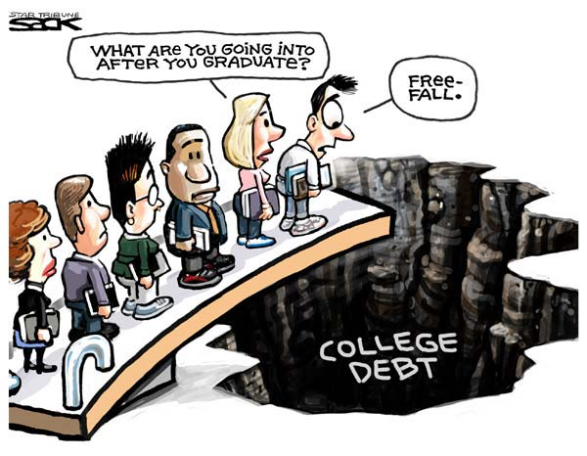
Notes:
Because people don’t know how the game is played, we see people lining up, jumping off and hoping for the best. Hope is not a great strategy.

Slide 10
Average family college debt:
$57,800+ in loans for
students & families per child
*Sources: Nerdwallet.com Got Parent PLUS Loans? Save Money With These Alternative Payment Plans and The Institute for College Access and Success accessed 8-18-17
Notes:
$37K is student loan, but now parents take on $20K debt per child.

Slide 11
2 Types of Aid
Need Based Aid
Merit Based Aid
Notes:
2 separate buckets of money, some families get to draw from both buckets but every family can draw from the merit bucket if they understand how it works.

Slide 12
2 Need-based aid forms
FAFSA vs. CSS/Profile
Expected Family Contribution (EFC)
Notes:
EFC is up to roughly 47% of the adjusted gross income

Slide 13
Biggest Influencers of Financial Aid
Income from tax return
Parent non-retirement assets
Number of children in college
Children’s assets and income (UGMA/UTMA, Grandparent donations)

Slide 14
Tip #1
If you will be need based at some schools, assure kid’s assets are not in their name!
Child assessed @ 20%
Parent rate is 5.64%
529 plans are assessed at parent’s rate, UGMA/UTMA at child’s rate

Slide 15
Tip #2
Review financial aid forms for accuracy
42% contain errors that cost a family money
FAFSA-Your primary residence and your retirement are not counted as assets
CSS/Profile is different

Slide 16
Merit Aid
AP, PSEO, standardized test scores, GPA, sports, etc.

Slide 17
Tip #3
To get the most merit aid, spend the majority of your time finding the right college!
(not private scholarships)

Slide 18
Scholarship/Grant Sources
6%
Employers
Federal government
40%
7%
Private scholarships
11%
State governments
Colleges
35%

Slide 19
Top 2 mistakes families make with merit aid?
Not all colleges offer merit aid!
Narrow the field of colleges too soon!

Slide 20
Look for schools …
Offer merit aid
Where student would bring something interesting:
Grades and test scores in the top 25-33%
Extra-curricular talents
Demographic mix in majors/campus

Slide 21
Tip #4
Consider Schools in other states
50% of students attend college within 100 mi of home
Most colleges have the bulk of applicants from local communities
Supply and demand is king – NYC vs Buffalo
Location can save families $15,000 a year

Slide 22
Tip #5
1 or 2 more points on the ACT or SAT
can be worth $1,000’s
Goal is to be in top 25% of college’s scores
Investment in test prep may be worth it
Test optional - If student does poorly on standardized tests consider 1000+ colleges that do not require them (www.fairtest.org)

Slide 23
Anatomy of 1 College’s Merit Aid
Demonstrated Interest- $3,000 (Don’t be “stealth” candidate)
Lives out of state-$2,000-$15,000
“A” in class-$62 for every “A” on transcript
Rigorous class-$400 for every AP, IB, etc.
Excellent letter of recommendation-$1,800
Increase ACT score-$425 for every point above avg.
FAFSA-$1,800 for completing
CSS/Profile-$2,500 for completing
Essay-$1,100-8,500 for excellent essay
Notes:
This is the recipe for one private college, although the amounts differ college to college, the categories are VERY common

Slide 24
Tip #6
Negotiate the financial aid award
Called an “appeal,” a little secret colleges don’t want you to know about
Need a reason like a better offer from another college, family circumstance change, etc.
Appeals can save families additional thousands if done correctly.

Slide 25
Tip #7
Start the spring of 10th grade
Time is the enemy of a great college search!
Research and then target schools based on predicted aid
Give yourself enough time to retake ACT if needed

Slide 26
We help navigate the complicated process and find the right fit

Slide 27
We help families save lots of money

Slide 28
We are a neutral third-party
that students listen to

Slide 29
Free Family Consultation
Answer the family’s questions
Estimate the (EFC), the gov’t expects you to contribute toward college
Advise on their eligibility for need-based and merit aid
Suggest strategies that align with goals

Slide 30
Housekeeping!
Take advantage of the college consultation
Student too young yet? Let us know and we’ll reach out at the appropriate time
Family Newsletter about important college information
Did you learn something new? Share us with the people you know!

Slide 31
Questions?
Cozy Wittman
cwittman@collegeinsidetrack.com
612-850-5729

