Slide 1
College Planning and Prep in the era of Covid-19
Chris Wills President, College Inside Track
Ron Michalak Founder, Breakaway Test Prep

Slide 2
College Planning and Prep in the era of Covid-19
Impact of Covid-19 on Testing
Upcoming changes to the ACT
Thoughts about the tests and test prep
Insider view of how to maximize financial aid

Slide 3
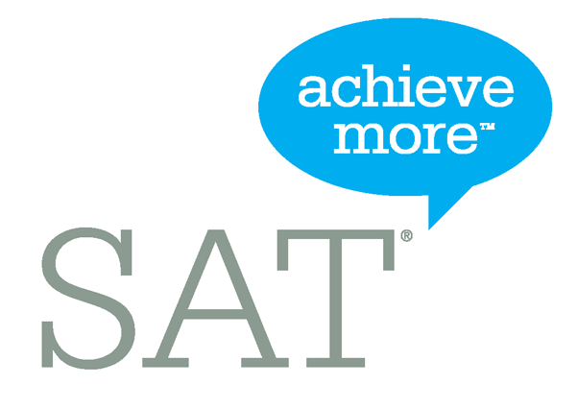
Updates from the ACT and SAT
The ACT cancelled its April 4th national test date, but left alone its June 13 and July 18 tests
In addition, the ACT announced makeup dates on June 20 and July 25
The SAT had scattered site closures in March; it went ahead and cancelled the May 2 and June 7 test dates
The SAT announced that registration for its late summer and fall test dates will be available the week of May 26; there will also be a new September 26 test date
Both organizations announced digital versions of their exams to be debuted sometime later this year

Slide 4
Latest test dates
June 13
June 20 makeup if June 13 cancelled
July 18
July 25 if July 18 cancelled
September 12
October 24
December 12
“At home” test available late fall or early winter
Intention to proceed with section retesting in October
August 29
September 26
October 3
November 7
December 5
Digital test available later this year
Registration for Aug-Dec tests available week of May 26
Early access for students shut out of May & June SAT or who have not tested yet

Slide 5
Changes coming to the ACT this fall
Section Retesting: Once students take a complete ACT test, e.g., September 2020, they will have the opportunity to retake one or more single-section subject tests to improve their scores.
Superscoring: A superscore is an ACT Composite score calculated using the highest subject scores from different test administrations.
Online testing: On national test days, students will be able to choose between online section testing and traditional paper testing. For students testing online, they will get test results more quickly, as soon as two business days.
“At home” ACT: Due to the Covid-19 crisis, the ACT will make a home version of the ACT available in the late fall/early winter

Slide 6
Practical concerns about the changes
Section retesting is largely irrelevant to students in the Class of 2021
Inevitable that there will be significant logistical issues in trying to deliver section retesting (July ACTs)
Challenges of delivering a consistent online experience to students (bandwidth, screen size, access to “hardened” computers)
Prep concerns about students targeting “weak” areas only and forgoing opportunities to improve on “strengths”

Slide 7
Strategic concerns about the changes
Section retesting appears to be an attempt by the ACT to compete with the SAT and its “superscoring-friendly” test
Admissions office software is not currently set up to deal with individual “section” scores from the ACT
Thus far, not a single college or university has said it will accept an ACT section score

Slide 8
Which test is best for me?
Which is the lesser of two evils for you? More time constrained or more challenging?
Take a practice ACT and SAT
Use a concordance table to compare results

Slide 9
ACT or SAT: what’s the difference?
Offered seven times each year
Dec, Apr, Jun – Q&A
Time-constrained
215 problems in 2:55
Straightforward
Math formula-heavy
Science section
English and writing similar
“Optional” 40-min writing section
40+ practice exams
“Redesigned” SAT debuted on March 5, 2016
Looks like the ACT
Offered seven times each year
Oct, Mar, May – Q&A
PSAT is a benchmark
Less time-constrained
154 problems in 3:00
No science section
“Optional” 50-min writing section
18 practice exams

Slide 10
When should I test?
Breakaway recommends testing three times over the course of junior and senior year
Ideally, you should take your first ACT (or SAT) during the first semester of junior year (algebra II?), a second test in your second semester, and your final test, as necessary, in September (ACT) or August or October (SAT)
Every student is unique, so your testing plan can be customized to meet the demands of your schedule

Slide 11
How to prepare for the tests
How to prep
Individualized process…what’s right for one student may not be for another
Lots of options: DIY, classes, private instruction, online programs
ALWAYS start with a practice test!
Take occasional practice tests to measure your progress
Expect to do homework
Never take a real test cold! Would you take a calc test cold?
Notes:
DIY – inexpensive, requires discipline, good test-taking skills, sound conceptual understanding of grammar, math, reading
Small group classes – moderately expensive, insights into key concepts and strategies, less individualized but more time in class
Private instruction – more expensive, tailored to your needs and schedule

Slide 12
When to prepare for the tests
When to prep
Consider:
Scheduling
Readiness
Level of commitment
Starting earlier provides opportunity to shore up weaknesses
Take advantage of the summer!
Fall of senior year is an excellent time to test
Sign up for a practice test with Breakaway

Slide 13
Insider view of how to maximize financial aid
3 Key Factors for Success
Academic
Social
Financial

Slide 14
Insider view of how to maximize financial aid
2 types of financial aid
Need-based aid
Merit aid

Slide 15
Insider view of how to maximize financial aid
College Inside Track Tip #1
To get the most merit aid, spend the majority of your time finding the right college!
(not private scholarships)

Slide 16
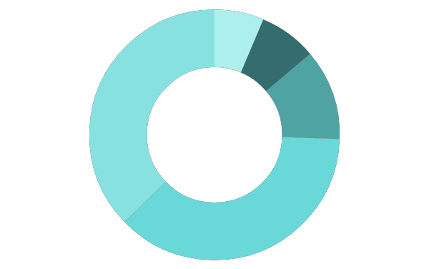
Scholarship/Grant Sources
6%
Employers
Federal government
40%
7%
Private scholarships
11%
State governments
Colleges
35%

Slide 17
The best scholarship money goes to the smart searchers!
Right fit college list
Most Return to Least Return
College acceptances
Local
Private

Slide 18
Insider view of how to maximize financial aid
Top mistake families make?
Not all schools offer merit aid

Slide 19
Insider view of how to maximize financial aid
Look for schools…
Offer merit aid
Where student would bring something interesting
Grades and test scores in the top 25-33%
Extra-curricular talents
Demographically interesting

Slide 20
Insider view of how to maximize financial aid
College Inside Track Tip #2
Consider colleges in other states
50% of students attend college within 100 mi of home
Most colleges have the bulk of applicants from local communities
Supply and demand is king – NYC vs Buffalo
Location can save families $15,000 a year

Slide 21
Anatomy of 1 College’s Merit Aid
Demonstrated Interest- $3,000 (Don’t be “stealth” candidate)
Lives out of state-$2,000-$15,000
“A” in class-$62 for every “A” on transcript
Rigorous class-$400 for every AP, IB, etc.
Excellent letter of recommendation-$1,800
Increase ACT score-$425 for every point above avg.
FAFSA-$1,800 for completing
CSS/Profile-$2,500 for completing
Essay-$1,100-8,500 for excellent essay
Notes:
This is the recipe for one private college, although the amounts differ college to college, the categories are VERY common

Slide 22
Insider view of how to maximize financial aid
College Inside Track Tip #3
Negotiate the financial aid award
Called an appeal
Need a reason
Can save families thousands

Slide 23
College Planning and Prep in the era of Covid-19
Housekeeping
College Inside Track free one-hour personalized college consultation
Follow us on Facebook
Take a FREE Breakaway ACT or SAT practice test (email Ron at ron@breakawaytestprep.com)
Did you learn something new? Share us with the people you know!

