Slide 1
bb
Insider Tips to Navigating
College Search for Student Athletes
Cozy Wittman
612-850-5729

Slide 2
3 Key Factors For Success
Academic
Social
Financial
Notes:
Today, 3 factors come together to create a great college search today

Slide 3
Quiz
As a percentage, how much has tuition increased at the University of WI since 1988?
134%
306%
480%
1053%
I need my T1 calculator to figure that out

Slide 4
University of WI increase since ‘88
1053%
Private College Tuition Increase
415%

Slide 5
SMU: $79,126
Boston College: $75,422
Northwestern: $81,256
NYU: $78,774
UC Berkley: $40,692*
Beloit College: $63,036
Lawrence University: $63,360
Penn State - $36,652*
University of WI: $27,228*
Notes:
UNC this year: $23,000 – this year.

Slide 6
2 Types of Aid
Need Based Aid
Merit Based Aid
Notes:
2 separate buckets of money, some families get to draw from both buckets but every family can draw from the merit bucket if they understand how it works.

Slide 7
2 Need-based aid forms
FAFSA vs. CSS/Profile
Expected Family Contribution (EFC)
Notes:
EFC is up to roughly 47% of the adjusted gross income

Slide 8
Biggest Influencers of Financial Aid
Income from tax return
Parent non-retirement assets
Number of children in college
Children’s assets and income (UGMA/UTMA, Grandparent donations)

Slide 9
Tip #1
If you will be need based at some schools, assure kid’s assets are not in their name!
Child assessed @ 20%
Parent rate is 5.64%
529 plans are assessed at parent’s rate, UGMA/UTMA at child’s rate
Two mistakes to avoid – no retirement and no home value on FAFSA

Slide 10
Merit Aid
AP, PSEO, standardized test scores, GPA, sports, etc.

Slide 11
Tip #2
To get the most merit aid, spend the majority of your time finding the right college!
(not private scholarships)

Slide 12
The best scholarship money goes to the smart searchers!
Right Fit College List
Most Return to Least Return
Colleges acceptances
Local
Private

Slide 13
Look for schools …
Offer merit aid
Where student would bring something interesting:
Grades and test scores in the top 25-33%
Extra-curricular talents
Demographically interesting

Slide 14
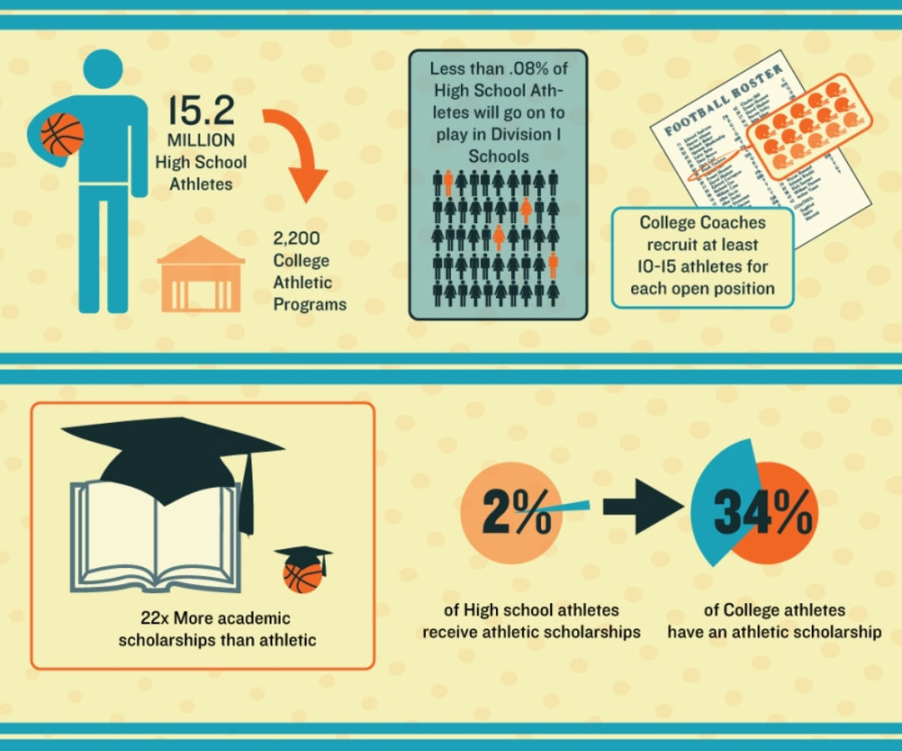
Realities of
College
Athletics

Slide 15
Assessing your college for fit as an athlete
Would you attend this school if you weren’t playing basketball
Talk not just to coaches but athletes
How will you feel if you don’t play
What is the academic support like for basketball
Is my money “sport” money or academic money
If the scholarship goes away, would you stay

Slide 16
Quiz
What percentage of students transfer at least once?
6%
14%
25%
38%
50%
Doesn’t everyone transfer?

Slide 17
The national transfer rate:
38%
Average cost of 1 transfer:
$14,000
Cost for 2 transfers:
$24,000*
*State school to state school – private to any other style of college is much larger

Slide 18
Why students leave
Don’t see court time
Coaching changes bring new recruits
Scholarship gets pulled
Injury
Burnout
Academic challenges
Run Multiple scenarios – no one thinks it will happen to them

Slide 19
3 Common Athletic Recruiting Mistakes
Don’t understand that most athletes don’t receive a full-ride scholarship
Can’t afford the school if the student doesn’t have a scholarship
Ignore D3 schools because they don’t provide athletic scholarships

Slide 20
Anatomy of 1 College’s Merit Aid
Demonstrated Interest- $3,000 (Don’t be “stealth” candidate)
Lives out of state-$2,000-$15,000
“A” in class-$62 for every “A” on transcript
Rigorous class-$400 for every AP, IB, etc.
Excellent letter of recommendation-$1,800
Increase ACT score-$425 for every point above avg.
FAFSA-$1,800 for completing
CSS/Profile-$2,500 for completing
Essay-$1,100-8,500 for excellent essay
Notes:
This is the recipe for one private college, although the amounts differ college to college, the categories are VERY common

Slide 21
The Value of Customized Search
Just like realtors understand the housing industry, college search professionals navigate the college search landscape and understand the “behind the scenes” things.
You can do it on your own, but you will often cost yourself money

Slide 22
Navigate the complicated process and find the right fit

Slide 23
Maximize the value of your college savings

Slide 24
A neutral third-party
that students listen to

Slide 25
Questions?
Cozy Wittman
College Inside Track
cwittman@collegeinsidetrack.com

Slide 26
Housing Game Plan

